Slide 1

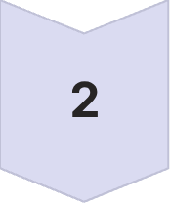
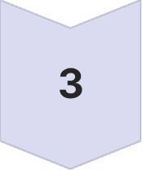
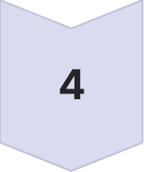
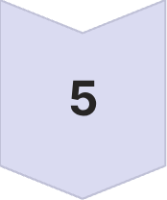
BEGINNER PHP FOR MOODLE
PHP Data, Loops and Moodle Safety
Beginner concepts for working with Moodle PHP
Data
Arrays & values
Repetition
for & foreach
Objects
Classes & Moodle
URLs
moodle_url
Security
Session keys
Learning Goals
Store related values in arrays
Repeat actions with for and foreach
Understand classes, objects and Moodle objects
Build safe dynamic URLs
Protect actions using session keys

Slide 2
ARRAYS
Indexed Arrays: One Variable, Many Values
An indexed array stores an ordered list. Its positions begin at 0.
$topics = ['HTML', 'CSS', 'PHP'];
echo $topics[0]; // HTML
echo count($topics); // 3
$topics[] = 'SQL';
Square brackets
Index 0
Is always the first item
Create or access an array element
[] appends
count()
Adds an item at the end
Returns the number of items

Slide 3

ARRAYS
Associative Arrays: Meaningful Keys
An associative array connects each value to a named key.
Indexed vs. Associative
$course = [
'shortname' => 'WEB101',
'fullname' => 'Introduction to Web Development',
'visible' => true
];
echo $course['fullname'];
Type | Access | Basis
Indexed array | $topics[1] | Position
Associative array | $course['fullname'] | Name
Values can have different types: text, numbers, and booleans. Keys must match exactly, including spelling.
Use associative arrays when each value has a clear label. This is still an array, not yet an object. Associative arrays use [ ]; object properties use the -> arrow operator.

Slide 4

LOOPS
Repeating Code: for and foreach
FOR , when the counter matters
FOREACH , when processing a collection
for ($i = 1; $i <= 3; $i++) {
echo "Attempt $i<br>";
}
$topics = ['HTML', 'CSS', 'PHP'];
foreach ($topics as $topic) {
echo $topic . '<br>';
}
Start
$i = 1 initialise once
Plain language
Condition
"For each value in $topics, temporarily call it $topic."
$i <= 3 test before each run
Naming habit
Update
Use singular/plural pairs: $topics / $topic
$i++ add one after each run
Associative variant
foreach ($course as $key => $value)
Use for for controlled counting; use foreach for each item in an array. Using < instead of <= in a for loop is a common off-by-one error.

Slide 5

Classes and Objects: A Simple Idea
A class is a plan or template. An object is one real thing made from that plan , just as a house plan describes what a house contains but is not a real house itself.
Simple PHP Example
Moodle Gives Us Ready-Made Objects
class Student {
public $name;
}
$student = new Student();
$student->name = 'Sam';
echo $student->name;
$USER->firstname
$CFG->wwwroot
Current user's first name
Moodle website address
$DB
$PAGE
Helps Moodle work with its database
Helps set up the current page
Explain the Symbols
new Student() creates an object
-> lets us access information inside an object
We usually use Moodle's objects, we do not create them ourselves.

Slide 6
Building Moodle Links with moodle_url
The Problem
What Each Part Means
Do not type the whole website address into every link, the site address may be different on another server, making hard-coded links unreliable.
1
'/course/view.php'
Better Moodle Method
The page to open , the internal Moodle path
$url = new moodle_url(
'/course/view.php',
['id' => 25]
);
echo html_writer::link($url, 'Open course');
2
['id' => 25]
Information sent to that page , a key-and-value pair (25 is an invented example)
3
'Open course'
The words the user clicks, the visible link text
Result
Open course → Moodle builds the correct address automatically.
moodle_url builds the address; html_writer::link makes it clickable.

Slide 7
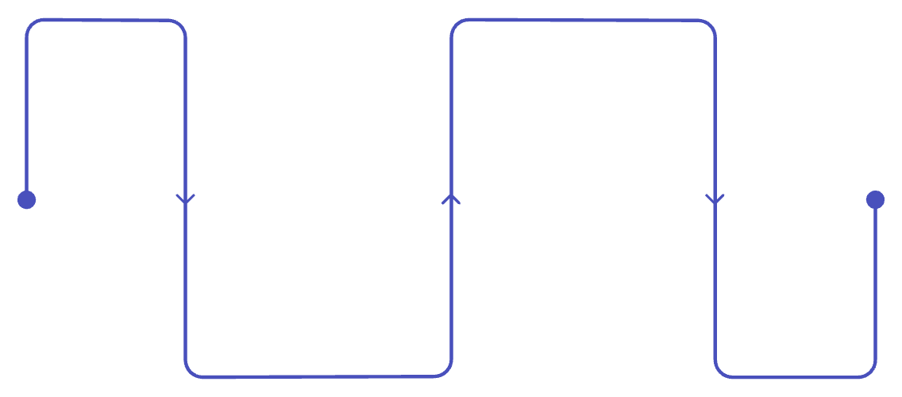
Session Keys: Checking That an Action Is Genuine
The Problem
A user is logged in. A harmful website tries to make their browser send an unwanted Moodle request. Because the user is already logged in, Moodle needs another way to check that the action came through the expected Moodle page.
Moodle's Protection
Three Separate Checks — Each Has One Job
Verify key
Check the same key on receiving page
Session Key
Is this a genuine request from this session? sesskey() adds a temporary secret value; require_sesskey() verifies it.
Add session key
Capability Check
Attach key to the action URL
Is this user allowed to perform the action? Session keys do not decide permission — this check does.
Creating the Action URL
$url = new moodle_url(
'/local/example/action.php',
['itemid' => 7, 'sesskey' => sesskey()]
);
Parameter Check
Is the supplied information valid? Ensure values such as itemid have the expected type and format.
Checking the Request
For actions that change data: login + session key + permission + valid input.
require_login();
require_sesskey();

Slide 8
QUESTION 1 • ANSWER
Question 1: Why Moodle uses PHP
WHY PHP?
ALL PAGES?
WHERE?
WHAT DOES IT DO?
To make pages respond to users, data and actions
No. Static pages can use HTML and CSS alone
The server executes PHP; the browser gets its result
checks access, processes input, uses APIs/data, builds output
PHP is Moodle’s server-side worker: it turns a request into the correct page or response for that user.
15

Slide 9
QUESTION 2 • ANSWER
Four essential programming concepts
Variables & constants
Decisions
Named values
Choose a path
$name = 'Ana';
const LIMIT = 10;
if ($score >= 5) { … }
Loops
Functions
Repeat work
Reuse behaviour
foreach ($users as $user) { … }
function total($a, $b) {
return $a + $b;
}
16

Slide 10
QUESTION 3 • ANSWER
English and PHP: similar purpose, different precision
Feature
Natural language: English
Programming language: PHP
Purpose
Communicate meaning between people
Give exact instructions to a computer
Rules
Grammar and conventions
Strict syntax and grammar
Ambiguity
Often understood from context
Usually causes error or wrong behaviour
Vocabulary
Very large and flexible
Limited keywords plus chosen names
Structure
Sentences and paragraphs
Statements, blocks, functions and files
17

